Slide 1
OneTogether
November 2018

Slide 2
Cleaning and clothing in theatre: protecting the patient from SSI
Professor Jennie Wilson
University of West London

Slide 3
Proportion of HCAI by type
Proportion of HCAI by type
At any one time:
8% of all patients have HCAI
5% of surgical patients have SSI

Slide 4
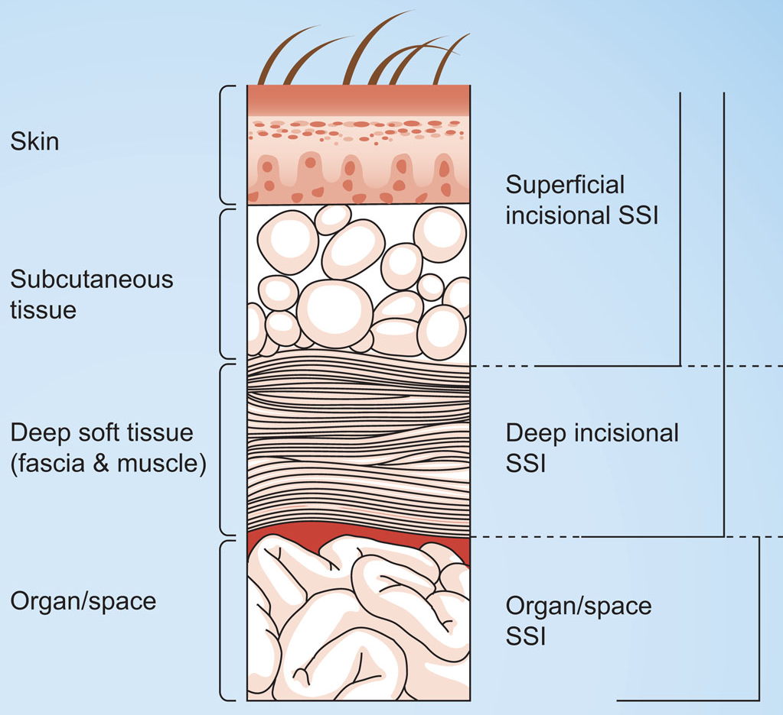
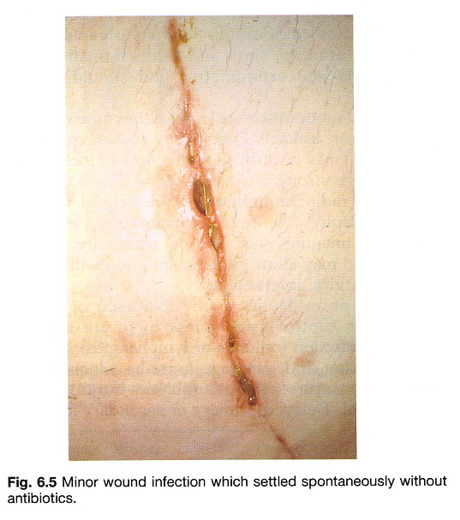
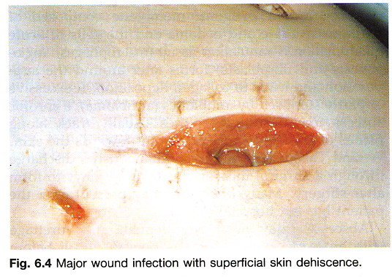
Types of surgical site infection

Slide 5
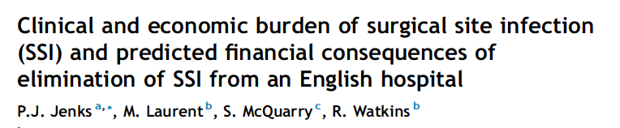
Major surgical procedures (2010-2012)
Analysis of SSI surveillance data and patient costing systems
An SSI increased length of hospital stay by 10 days (95%CL 7 – 13)
Nearly 5000 bed days lost
Cost £5000 per SSI
Total cost to hospital £2.5K over 2 year period
JHI 2014

Slide 6
Effect of SSI on long term morbidity
Case-control study of 59 SSIs after orthopaedic surgery
  14 extra days in hospital (up to 1 year)
  ↑ hospitalisations and operations
  ↑ costs x4
  ↓ quality of life (>5 point ↓ in SF-36 score for 5 domains – esp. physical functioning/role)
Whitehouse et al 2002
ICHE (2002) 23:183-9

Slide 7
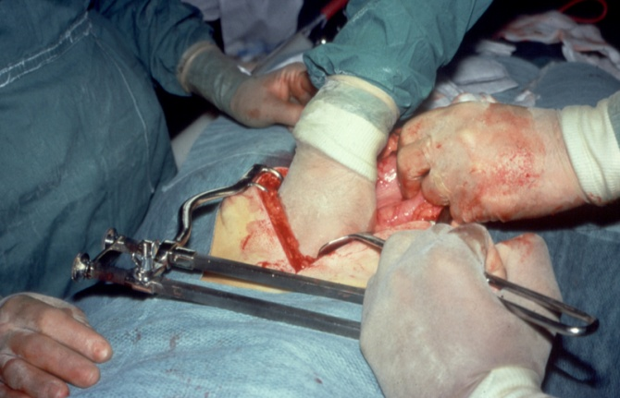
Risk factors for SSI
Underlying illness
Obesity
Age
Host patient
Surgical procedure
Micro-organisms
Number
Virulence
Type
Duration
Technique
Notes:
7

Slide 8
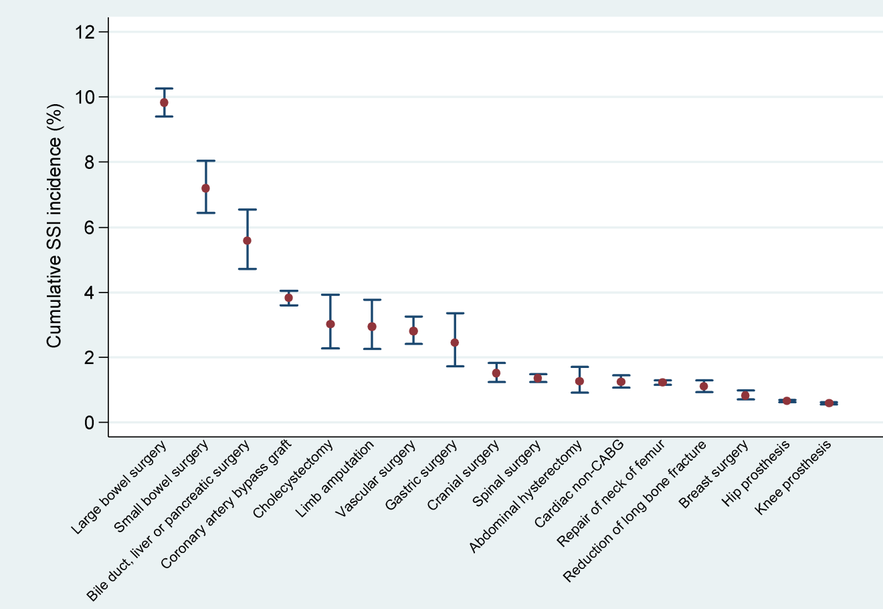
Rate of SSI by category of surgery
SSISS March 2016

Slide 9
Microorganisms causing SSI

Slide 10



Principles of SSI prevention
Avoid introduction of micro-organisms to operative site
    decontaminate skin, sterile equipment, minimise airborne particles
Prevent multiplication of microorganisms at operative site
    Antibiotics
Enhance patients defences against infection
    minimise tissue damage/surgeon technique, periop warming
Prevent micro-organisms accessing wound post-operatively
Notes:
10

Slide 11

Theatre ‘discipline’
Training people to obey a code of behaviour
Surgical scrub
Theatre clothing – patient & staff
Maintaining sterile field
Minimising contamination of the environment (➔ incision)
Maintaining a clean/safe environment

Slide 12
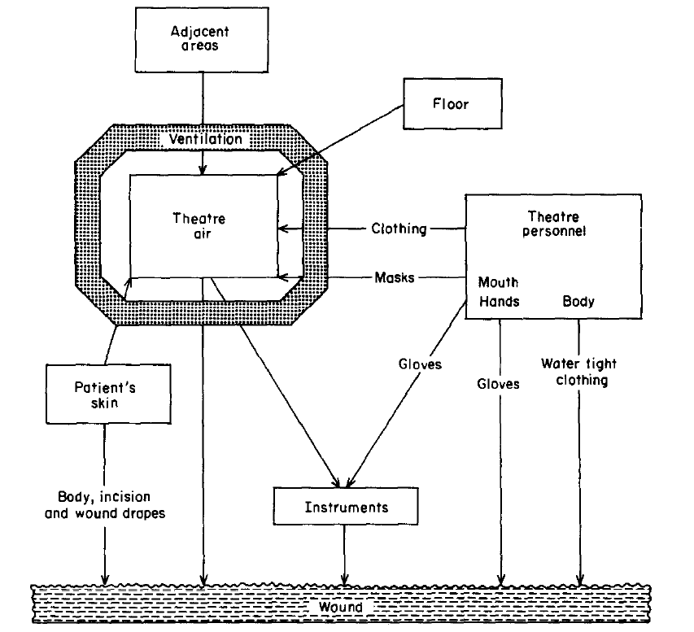

Routes & sources of infection in theatre
Surfaces
Staff & patient primary source of contamination
Minimise transmission using protective clothing and drapes

Slide 13
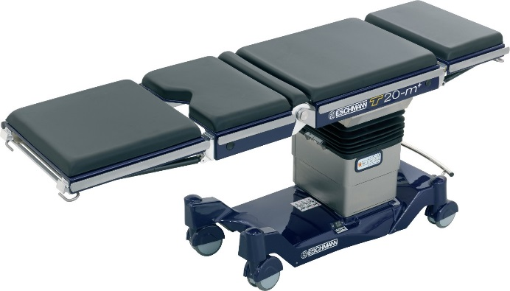
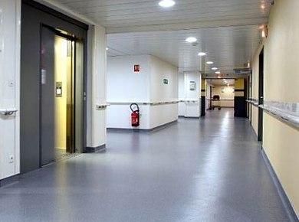
Risks from the theatre environment
Equipment used in the operating field
Equipment used outside the operating field
Environmental surfaces
Main contamination risks:
Blood & body fluids
Dust
The greater the contact with the patient - the more important the surface

Slide 14
Aim of cleaning
Remove as many microorganisms as possible from surfaces in direct contact with patient
Remove contamination with blood and body fluids
Prevent the build-up of dust on equipment in, or brought in to, the operating room

Slide 15

Dust accumulates on horizontal surfaces
Dust = skin squames & fabric particles
Some dust particles carry microorganisms
People shed outer layer of epidermis every 24hrs
Equates to 10⁹ cells/day
Whyte, 1988

Slide 16
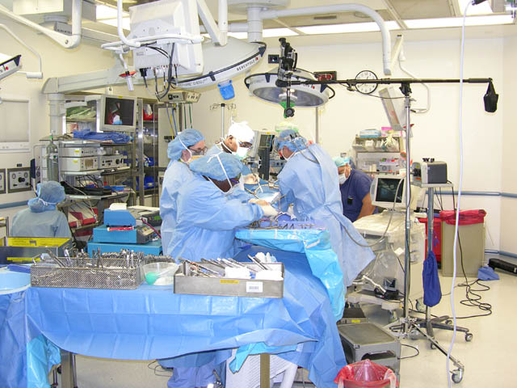
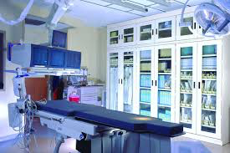
Minimise dust collection on surfaces

Slide 17
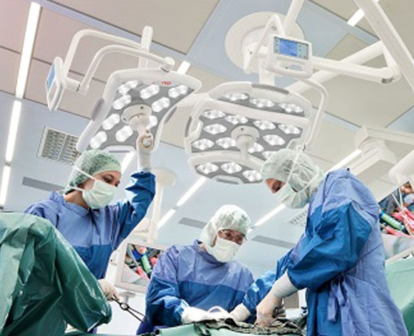
High touch surfaces
Contamination on operating light greater than on floors
Hambreaus et al 1980

Slide 18
Strategy for cleaning different types of surface in theatres
WHO Global Guidelines For the Prevention of SSI 2016
Surface Type | Definition | Cleaning requirement
High hand-touch surface e.g. operating table & light | Any surface that has frequent contact with hands | Frequent cleaning with detergent
Minimal touch surface e.g. floors, walls | No in close contact with patient; minimal contact with hands | Regular cleaning with detergent
Administrative areas e.g. offices, rest areas | No contact with patients | Usual domestic cleaning
Medical equipment e.g. Xray, scanner | Equipment used within surgical field | Clean with detergent before bringing into theatre and after removal
Other equipment e.g. IV pumps, vital signs monitors | Equipment used outside surgical field | Protocols for regular cleaning with detergent; decontamination if soiled with blood
Blood/body fluid on surface | Surfaces visibly contaminated with blood/body fluids | Prompt cleaning with detergent and disinfection

Slide 19
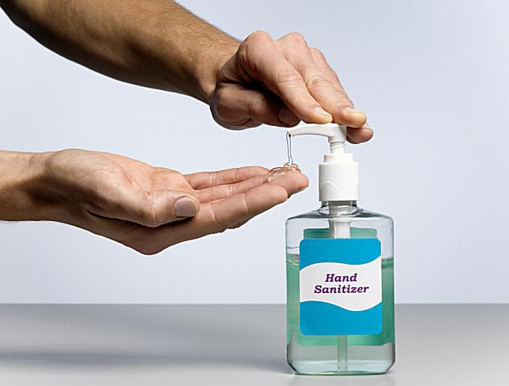
How frequent is ‘frequent’?
Key principles
  High touch surfaces after each patient
  Remove blood/organic material promptly
  Prevent build up of dust
  Micro-organisms always present on environmental surfaces
  Hand hygiene immediately before patient contact

Slide 20
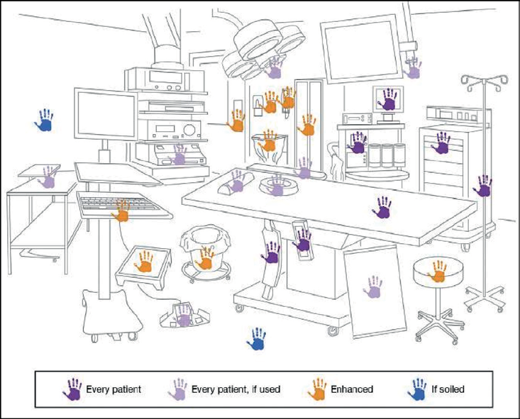
How and when to clean the environment
At the beginning of each day
    all flat surfaces wiped with a clean, lint-free moist cloth to remove dust and lint
Between cases
    hand touch surfaces
    surfaces that may have come into contact with patients blood and body fluids (wiped clean with detergent and then disinfectant) and allowed to dry
WHO Global Guidelines (2016)

Slide 21
Classification of equipment decontamination
Category | High [Critical] | Intermediate [Semi-critical] | Low [Non-critical]
Definition | Devices in contact which break skin/mucous membrane or enter sterile body cavity | Devices in contact with mucous membranes or non-intact skin | Items in contact with intact skin
Level | Kill all microorganisms | Kills all microorganisms, except bacterial spores | Removes pathogenic micro-organisms
Method | Sterilise | High level disinfection; sterilisation | Clean with detergent
Example | Surgical instruments | Anaesthetic equipment; flexible endoscopes | Environmental surfaces;

Slide 22
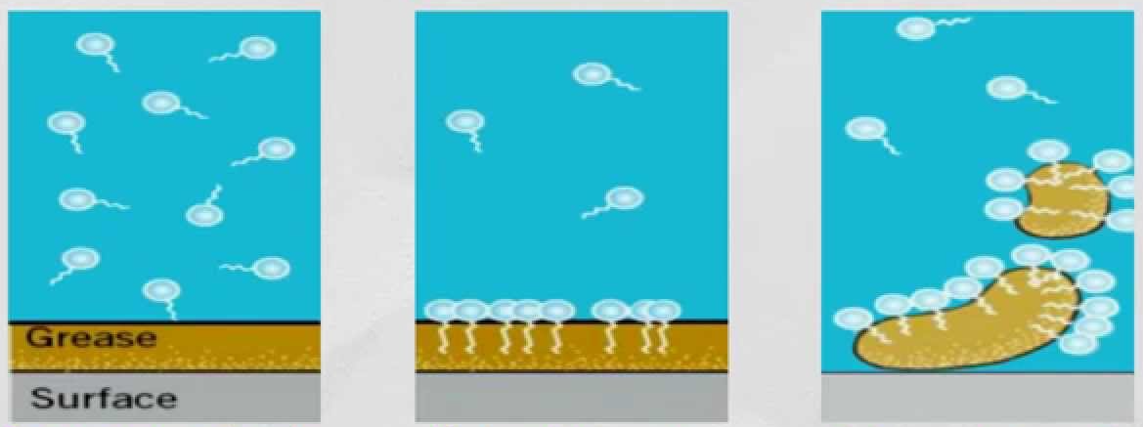
Why detergent?
Detergent dissociates in water
Hydrophilic region dissolves in water, hydrophobic region dissolves in grease
Detergent lifts off when shaken in water

Slide 23
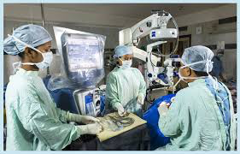
Beware of dusty equipment!
Explicit protocols for surface cleaning
Defined responsibilities
Large equipment in open corridors accumulate dust
    clean before bringing in to theatre
    Store in closed cupboards

Slide 24
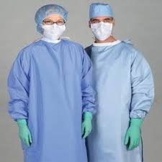

Theatre clothing
Protect vs BBF
Minimise wound contamination
  Scrub suits
  Masks
  Gowns

Slide 25
Surgical Masks
Bacteria-carrying particles expelled from mouth during speaking
    36 from 100 words loudly; 710 from cough; 40,000 from sneeze (Duguid 1946)
Large particles settle quickly; small particles evaporate and become airborne
Mask captures particles expelled from mouth
Difficult to study (far more bacteria-carrying particles released from body!)
2 quasi-RCT show no difference in rate of SSI masks vs no masks:
    1429 clean surgery: Masks = 1.8% SSI (13/706) vs No masks 1.4% SSI (10/723) (not SS)
    41 gynae ops – 3/10 with no masks developed SSI and study stopped!
Conclusion:
No evidence that masks prevent SSI (NICE 2008, Vincent & Edwards 2016)
Important to protect vs blood splashing
Remember they become contaminated during use so DO NOT TOUCH!

Slide 26
Surgical gowns
People shed 10⁹ skin cells per day
    Average particle size = 20μm
    Majority of S. aureus dispersed from under the waist (12% of people are perineal carriers)
Many particles carry bacteria
    Thousands of cells produced by surgical team every minute
Air well-mixed so all staff contribute particles which are circulated around room
    Will drop directly onto surgical site for those closest
Cotton fabric reduces dispersal rate but not much
    Pass through material (pores = 80μm)
    Escape from underneath gown

Slide 27
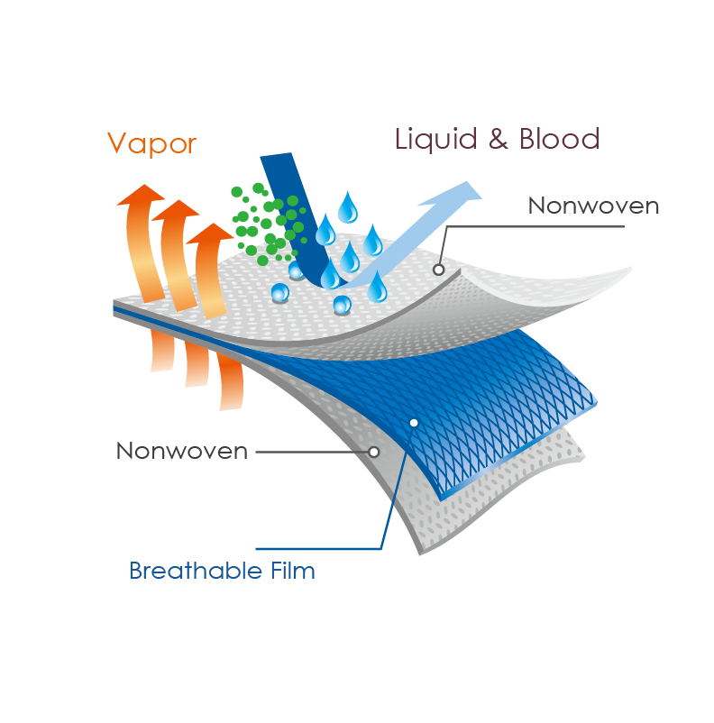
Gown material reduces dispersion
Tight weave material - pore size 20μm but very hot to wear
    Ventile pants tried in the 1980s – too hot!
Non-woven material
    fibres create ‘mat’ structure - prevents direct passage for particles
    but allows air circulation
Permeability also important
    Between 10 and 90% of operations result in wet-strike through of gown depending on depth of wound (Holborn 1984)
    Bacteria from skin able to transfer through wet material
Drapes prevent transfer of bacteria from patients’ skin into wound
    Become contaminated during procedure
    İmpermeability important to prevent transfer from patients’ skin
EN 13795 (2013)
    Resistance to dry/wet penetration; liquid penetration; tensile strength & linting

Slide 28
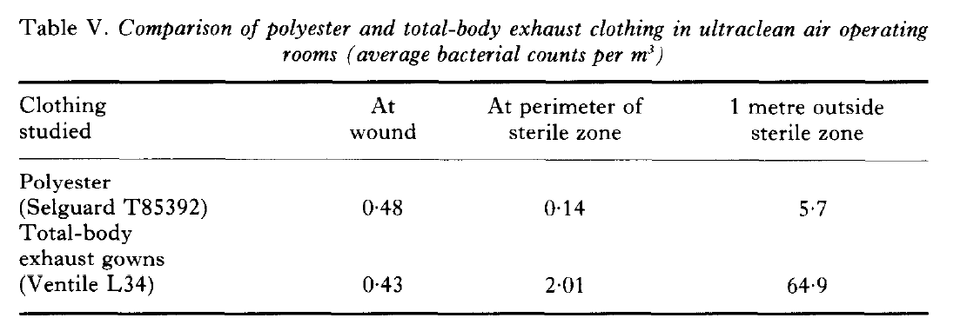
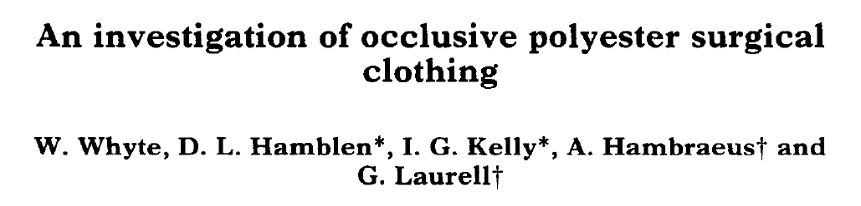
Total number of people in theatre add to airborne bacteria count

Slide 29
‘Best practice’ associated with low rates of SSI
117 hospitals
113,891 general & vascular operations
Low and high outliers identified from high quality surveillance data
1. Survey: Process and structural components of care
2. Site visits: observe practice; structured interviews
Campbell et al J Am Coll Surg 2008

Slide 30
Theatre discipline makes a difference
The structural and process of care characteristics had a significant association with low rates of SSI
Structure/process characteristics
Low ratio trainees/beds*
Policy on minimising traffic in OR*
Perioperative efficiency >15% shorter
      Door to skin; skin to door
Site observation
Low staff turnover
Positive safety culture
Strong leadership for quality improvement
Environment fostered communication
* Statistically significant

Slide 31
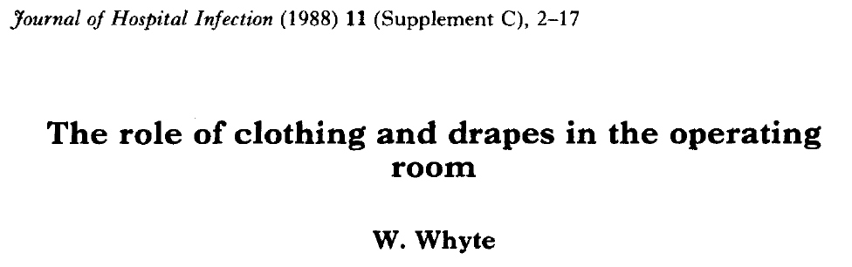
Sources of information

